Slide 1
Speeding Up an Ensemble Classifier using Oozie
and Amazon AWS
Shubhangi Rakhonde
Yashi Kamboj
Zayd Hammoudeh

Slide 2
Project Overview
Kaggle Competition: Classify recipes into different cuisine types [1] based solely off the recipe’s ingredient list.
An ensemble classifier for this dataset already exists, but its execution time is long.
Goal: Develop a faster, Hadoop-based version of the original classifier and deploy it to Amazon AWS.
[1] Dataset had 20 different international cuisine types including:
French, British, Mexican, Chinese, Indian, Southern US, Japanese, etc.
Notes:
Tree can be very large

Slide 3
Due to the interest of time, we will only discuss a subset of the components of our overall implementation structure.

Slide 4
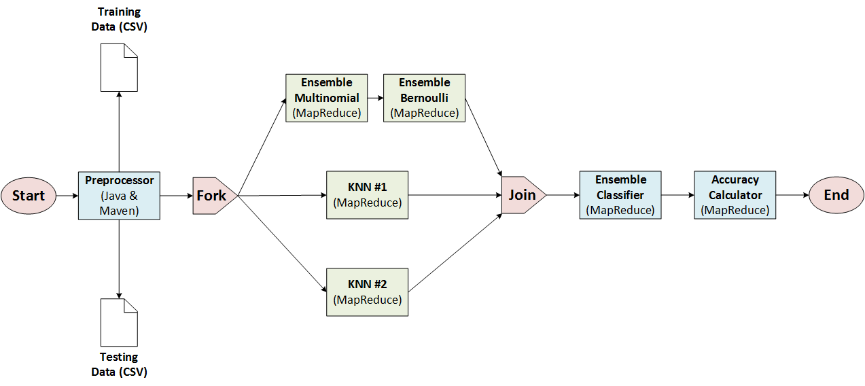
Oozie Flow with Fork/Join
Note: KNN approaches #1 and #2 above use different distance metrics

Slide 5
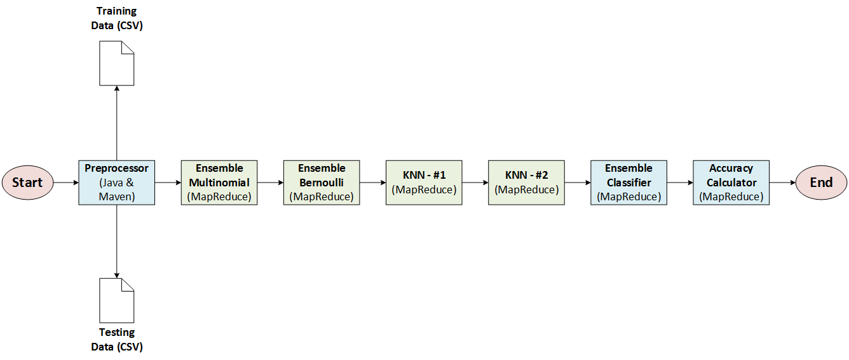
Oozie Flow with Successive Execution
Note: KNN approaches #1 and #2 above use different distance metrics

Slide 6
Data Preprocessor
Implemented in standard Java with the GSON library and Maven
Input Dataset Format: A list of JSON objects that contained each recipe’s cuisine type as well as its list of ingredients’ names
Modified the original algorithm’s preprocessor to make them more “MapReduce-Friendly”
Changed the ingredient names from strings to unique integers to make the classification algorithms’ structure more universal
Change the record format from JSON to a single comma-separated line. This was done to support MapReduce’s default record reader.
Splits testing data set into multiple files to allow them to be processed by multiple mappers in parallel

Slide 7
Multinomial & Bernoulli Naïve Bayes
Implemented using standard MapReduce
Calculates the prior probability of each ingredient for each cuisine type using the input training set.
Calculates the class probability of each record in the testing set. Returns each record’s class probability to the ensemble classifier.
To simplify code design and testing, we used the strategy pattern for calculating the distance.
Training set is rebuilt from scratch inside each mapper.
Future Improvement: Use serialization to import a prebuild training set data structure reducing the algorithm’s overhead.

Slide 8
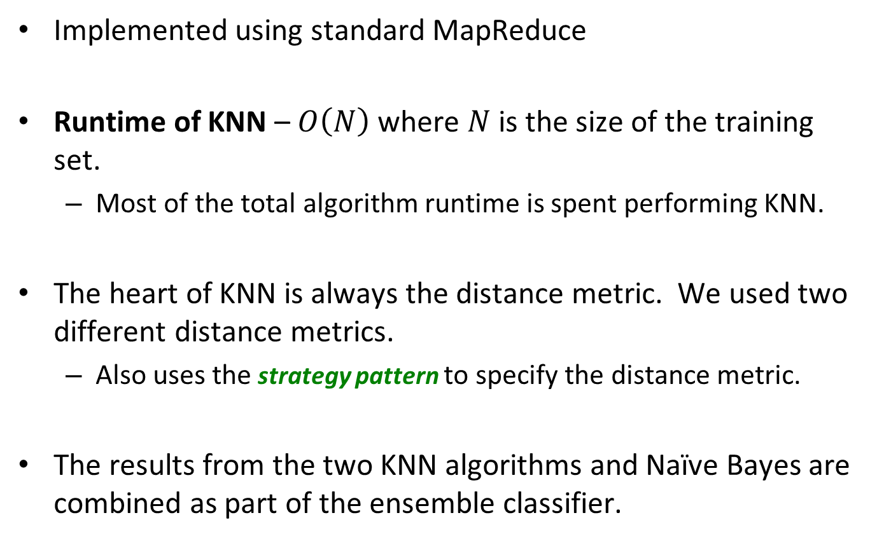
K-Nearest Neighbors (KNN)
Implemented using standard MapReduce
Runtime of KNN – $O\left(N\right)$ where $N$ is the size of the training set.
Most of the total algorithm runtime is spent performing KNN.
The heart of KNN is always the distance metric. We used two different distance metrics.
Also uses the strategy pattern to specify the distance metric.
The results from the two KNN algorithms and Naïve Bayes are combined as part of the ensemble classifier.

Slide 9
Amazon Web Services (AWS) Cluster
Amazon – Largest public cloud provider
Cluster Specifications
Operating System: Redhat Enterprise 6.5, 64 bit
Hadoop Environment: MapR-FS
Number of Nodes: 3
MapR-FS Version: 4.0.1
Oozie Version: 4.0.1
Cluster Type: m1.large
Virtual CPU: 2
RAM: 7.5 GB
Special thanks to Professor Casaletto for helping us configure the cluster.

Slide 10
Results
10

Slide 11
Algorithm Execution Time Comparison
AWS Speed-up: 48%
While this speed-up is good, we had hoped for more.
On a cluster with more nodes, we expect we could reduce the execution time an additional 15-20%.
Using an Oozie fork was about 26% slower than using successive execution.
We believe this slowdown was caused by the limited resources in our debug cluster.
Environment | Runtime (in Minutes)
Original Algorithm | 183
Class Sandbox with Fork | Deadlock
Class Sandbox Successive Execution | 161
AWS with Fork | 129
AWS Successive Execution | 95

Slide 12
Important
Takeaways
12

Slide 13
MapR-FS – You Don’t Miss it Until Its Gone
When originally debugging on AWS, we were not able to get MapR-FS running on our cluster so we used standard HDFS.
Operations that just worked on MapR-FS required different, more complicated procedures on standard HDFS.
Takeaways:
MapR-FS is more useful than we knew since we have never worked with the alterative.
Consider getting experience with standard HDFS environments as many employers may not run MapR-FS, and you probably do not realize what you take for granted.
Notes:
Tree can be very large

Slide 14
Fall-In Love with Custom MapReduce Configurations
In our class lab exercises, we did not have to use custom MapReduce configurations.
Custom MapReduce configurations are very powerful. Specific uses of them in our project include:
Passing the training set file location
Strategy pattern selection of distance metric for KNN
Takeaway: Custom configurations can streamline implementation schemes and enable significant flexibility.
<property>
<name> trainingFile </name>
<value> ${trainingSetFile} </value>
</property>
<property>
<name> NaiveBayesModel </name>
<value> bernoulli </value>
</property>
Custom MapReduce Configuration
from our Oozie XML Workflow

Slide 15
List of References
“What's Cooking?,”. [Online]. Available at: https://www.kaggle.com/c/whats-cooking. [Accessed: 2015].
“Jaccard index,” Wikipedia. [Online]. Available at: https://en.wikipedia.org/wiki/jaccard_index. [Accessed: 2015].
P. Tan and M. Steinbach, Introduction to Data Mining. Boston: Pearson Addison Wesley, 2005.
“google-gson,” GitHub. [Online]. Available at: https://github.com/google/gson. [Accessed: 2015].
W. Ochandarena, “Spinning Up a Hadoop Cluster in the Cloud | MapR,” MapR Blog. [Online]. Available at: https://www.mapr.com/blog/spinning-hadoop-cluster-cloud. [Accessed: 2015].
“Maven in 5 Minutes,” Apache Maven Project. [Online]. Available at: https://maven.apache.org/guides/getting-started/maven-in-five-minutes.html. [Accessed: 2015].

Slide 16
Updated Division of Responsibilities
Preprocessor: Zayd Hammoudeh
Naïve Bayes: Shubhangi Rakhonde
KNN: Yashi Kamboj, Shubhangi Rakhonde
Ensemble Classifier/Accuracy Calculator: Zayd Hammoudeh
Oozie Debug: Zayd Hammoudeh, Shubhangi Rakhonde
Training File Distribution Paradigm: Shubhangi Rakhonde
HDFS Debug: Zayd Hammoudeh
Amazon AWS: Zayd Hammoudeh, Yashi Kamboj

Slide 17
Questions?
17

Slide 18
Appendix
18

Slide 19
AWS Cluster Administration – Not So Easy
Configuring an AWS cluster was more difficult than we had anticipated.
In our sandbox, we only setup a single instance (and some of use even struggled with that). Bringing up and managing multiple, parallel instances is more complicated.
Amazon’s Elastic MapReduce (EMR) service should make this process simpler, but we went with EC2 instances due to their lower cost
Takeaways:
If your future company has a system admin, become his/her friend as it is can be pain to figure out how to configure AWS yourself.
If you need to do the system administration yourself, do not despair as you learn a lot of new (and unexpected) things along the way.
Notes:
Tree can be very large

